Slide 1
Deep Learning
Deep learning and Machine Learning tend to be used interchangeably, it’s worth noting the differences between the two. Machine learning, deep learning, and neural networks are all sub-fields of artificial intelligence. However, deep learning is a sub-field of machine learning, and neural networks is a sub-field of deep learning.
The way in which deep learning and machine learning differ is in how each algorithm learns. Deep learning automates much of the feature extraction piece of the process, eliminating some of the manual human intervention required and enabling the use of larger data sets. Machine learning is more dependent on human intervention to learn. Human experts determine the set of features to understand the differences between data inputs, usually requiring more structured data to learn.

Slide 2
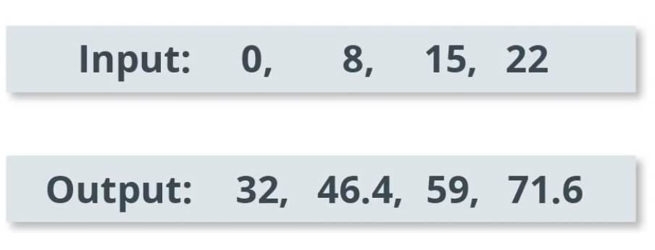
A problem
Let's see a problem. Suppose we are given the following input and output values. So, when we input a value of 0, we get an output value of 32 and when we input a value of 15, we get an output value of 59 and so on. Can we figure out what will be the output value if the input value is 38?
It’s 100.4. So how did we just solve the problem? If we look closely to the input and output values, we will see that the input and outputs are related via the equation, F = C*1.8 + 32 where F is Fahrenheit and C is Celsius. In other words, the input represents a temperature value in Celsius and the output represents a temperature value in Fahrenheit. For example, when the input is C=0, the output is, F = 0*1.8 + 32. That is, F = 32. What we just did here, figuring out the relation between input and output, can be modelled using ML algorithms. That is, given a set of input and their corresponding output, ML algorithms can be trained to figure out the correct parameters required to convert the inputs to outputs. However, you might need a lot of training samples to figure this out, though.

Slide 3
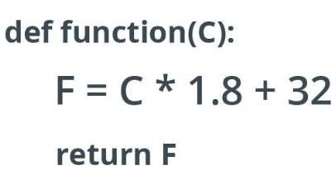
The problem : How we solve in function
The conversion of Fahrenheit to Celsius can easily be done in any programming language using a function. In python for example this function will look like this
Input
Here, the function takes the input value C and then computes the output value F by using this function and finally returns the output value F.
Algorithm
Output

Slide 4
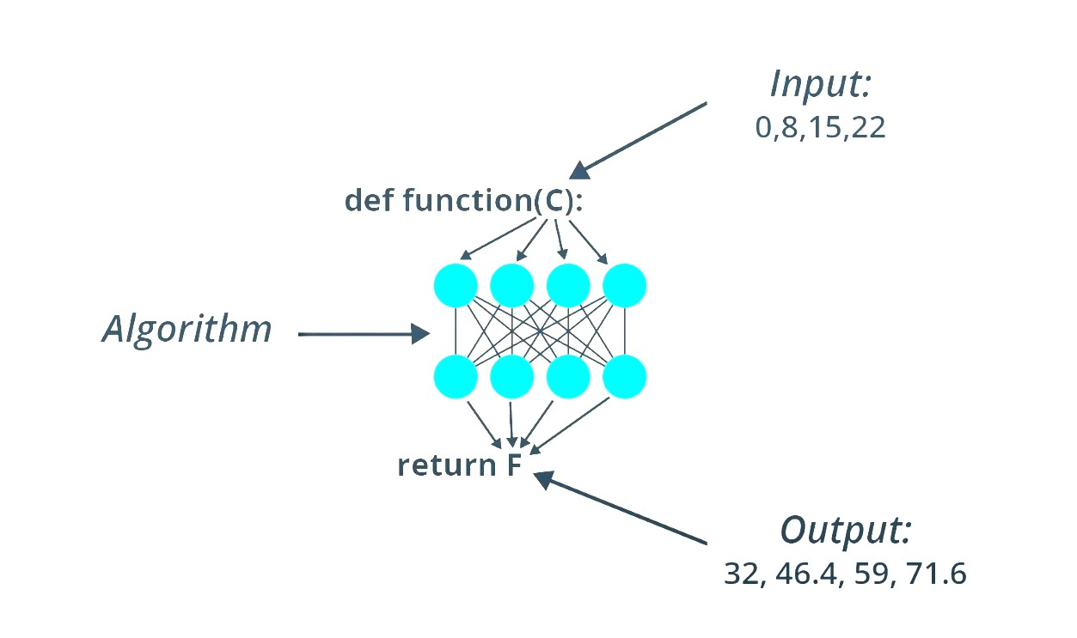
The problem : How Deep Learning Solves
On the other hand, in the machine learning approach we have the input and output but not the algorithm. Here, DL approach consists of using a neural network to learn the relation between input and output. We can think of neural network as a stack of neural network layers where each layer consists of some predefined math and internal variables. The input value is fed into the network and flows through the stack of layers doing some form of computation on its way. In order for the neural network to learn the relation between inputs and outputs we have to train it. We will formalize these notions in the coming slides.

Slide 5
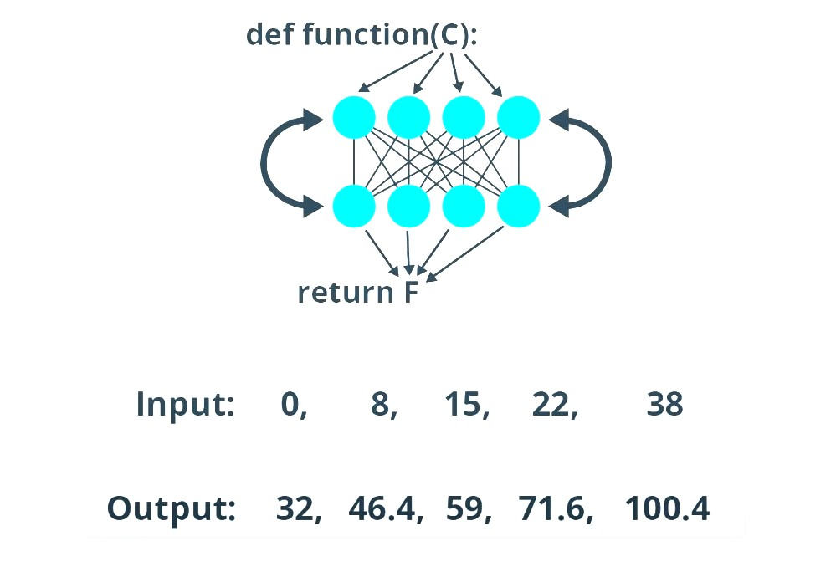
The problem : How Deep Learning Solves Cont.
We train our neural network by repeatedly letting the network try to map the input to output. Naturally, this needs many input-output data samples. While training, we tune the internal variables in the layers until the network learns to produce the required output given the inputs. As we all see, the training process to teach the network to tune its internal variable is performed for thousands or even millions of iterations over the input data and output labels. In very simple term, we can think of the machine learning algorithm as a function that can tune variables in order to correctly map some inputs to some outputs. Since we are generating a number here, this example covers a simple neural network regressor.

Slide 6







The problem : How Deep Learning Solves Cont.
units=1
$$h$$
$$x$$
$$w$$
$$\tilde{y}$$
Back Propagation
layer0
Iteration
Input Layer
(input)
Hidden Layer
Output Layer
(prediction)
Actual Output
(label)
Compute Error
(loss)
1
0
$$h = f\left(x\right)=w_{it_{1}}∗x+b_{1}$$
12.1
32
Loss(12, 32) -> very large
2
0
$$h = f\left(x\right)=w_{it_{2}}∗x+b_{2}$$
19.9
32
Loss(19.9, 32) -> moderately large
…
n
0
$h = f\left(x\right)=w_{it_{n}}∗x+$ $b_{n}$
31.4
32
Loss(31.4, 32) -> very small

Slide 7
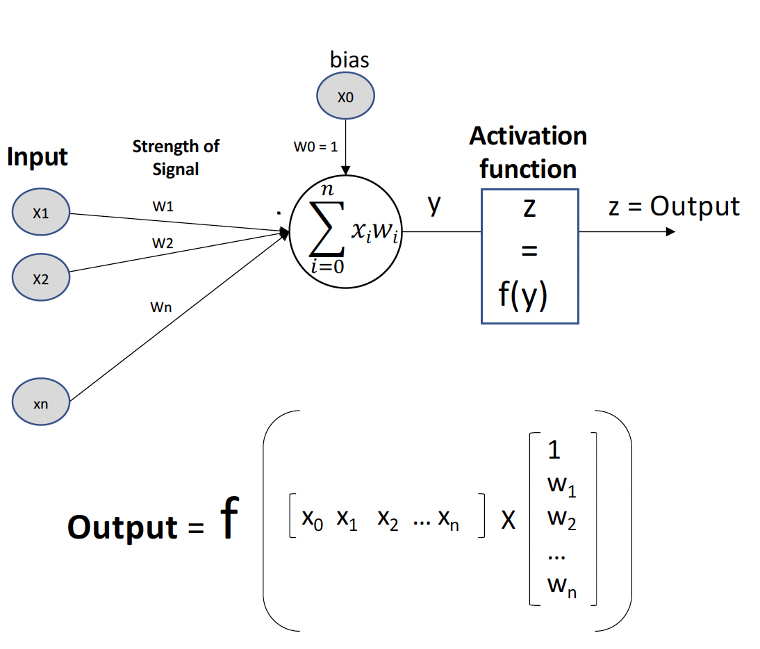
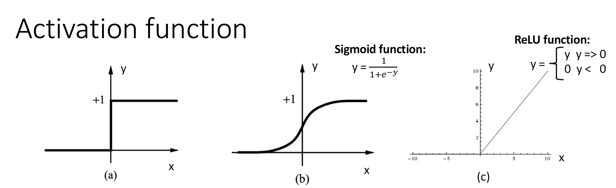
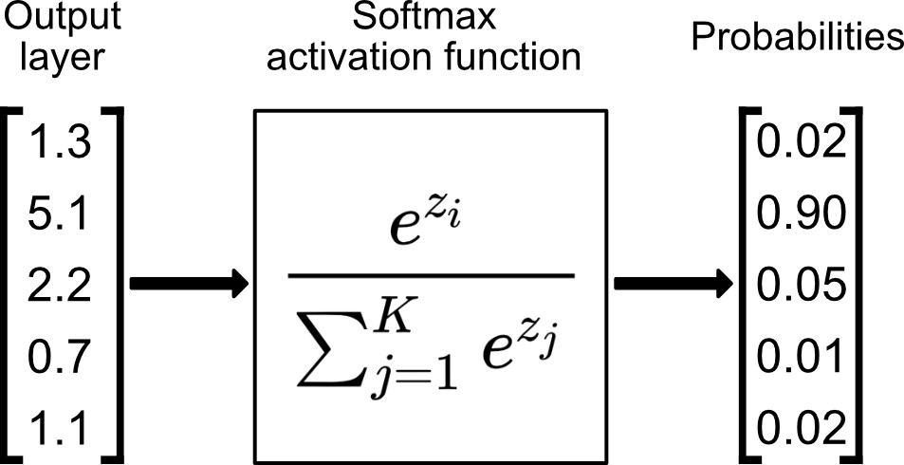
Activation Functions
(a) Is a step function or threshold function
(b) is a sigmoid function y = 1/(1+e-x)
(c) ReLU function
Sigmoid takes a real-valued input and squashes it to range between 0 and 1
Softmax converts the input vector to a probabilistic domain. This is very important for us for the final output layer.

Slide 8
Implementing ML algorithms in Code - Tensorflow
In the Colab, we created a model to convert temperature from Celsius to Fahrenheit, where we use simple one-layer neural network to find the relation between degrees Celsius and degrees Fahrenheit. We used Tensorflow to implement the neural network.
“TensorFlow is an end-to-end opensource platform for machine learning. It has a comprehensive, flexible ecosystem of tools, libraries and community resources that lets researchers push the state-of-the-art in ML and developers easily build and deploy ML powered applications.” – https://www.tensorflow.org

Slide 9
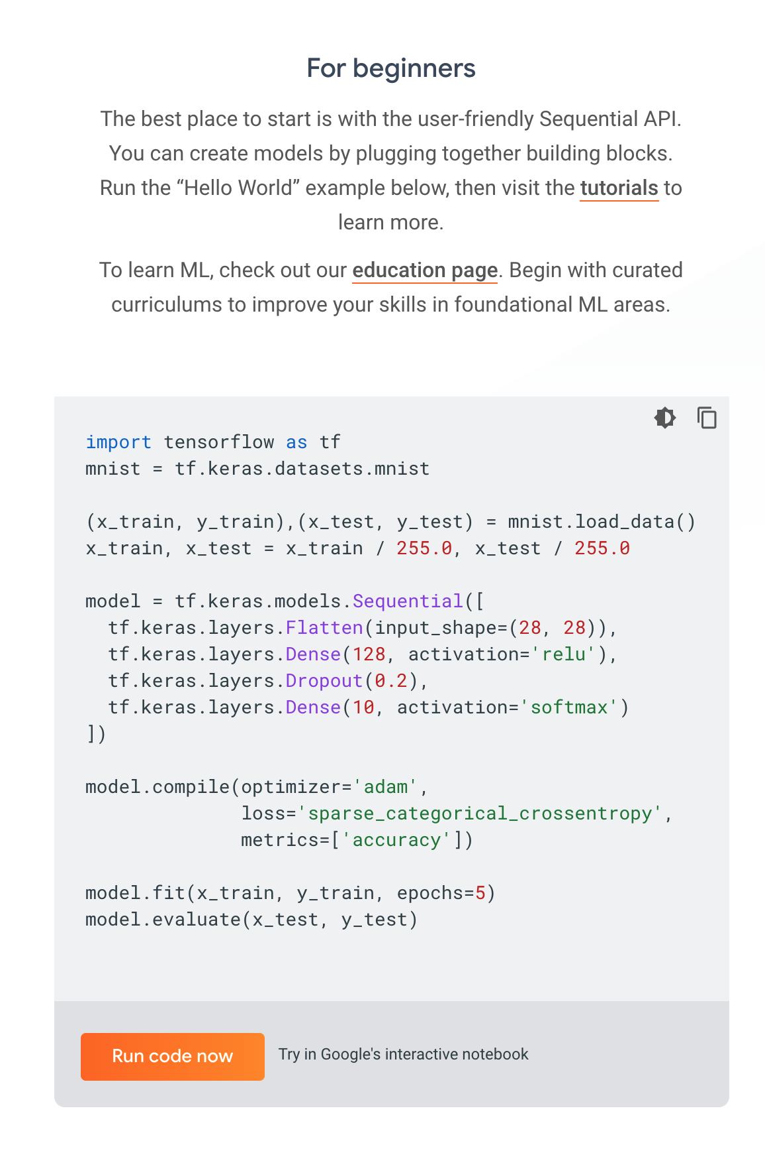




This is a screenshot from the tensorflow.org/overview website. This example trains a two-layer neural network to recognize handwritten digits. Like we did with Numpy and Pandas in Week 1 and 2, we will browse the tensorflow documentation to learn more about the API of tensorflow.
We will go write similar code to create a neural network to convert temperature from Celsius to Fahrenheit.
We will focus on building a single-layer, single-unit DNN. Such neurons are historically known as perceptrons.
units=1
$$h$$
$$x$$
$$w$$
$$\tilde{y}$$
layer0
Input Layer
Hidden Layer
Output Layer

Slide 10
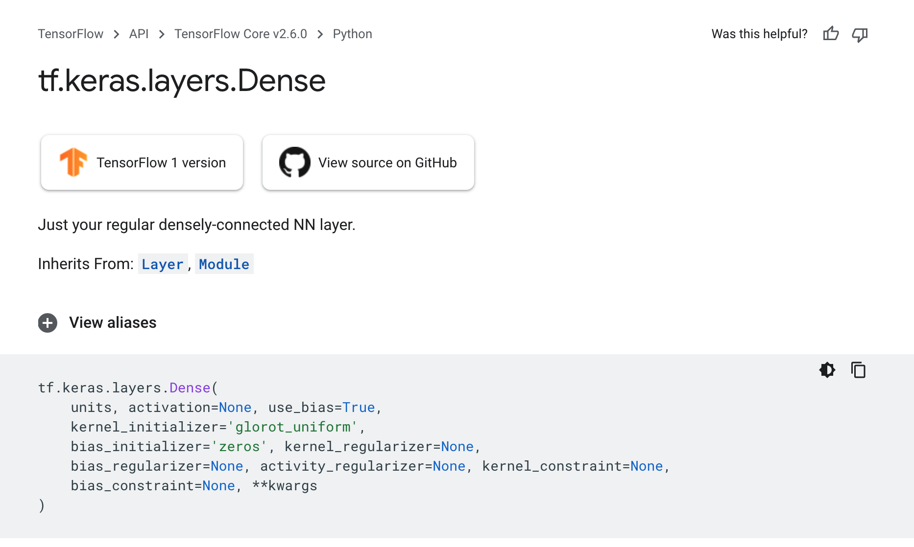
Dense Layer API
https://www.tensorflow.org/api_docs/python/tf/keras/layers/Dense
Notice that we are using Keras wrapper on Tensorflow. Hence all layers will be called from tensorflow.keras.layers.

Slide 11




units=1
$$h$$
$$x$$
$$w$$
$$\tilde{y}$$
layer0
Input Layer
Hidden Layer
Output Layer
layer0 = tf.keras.layers.Dense(units=1, input_shape=[1])
model = tf.keras.Sequential([10])
This is how we can define a one-layer one-unit neural network in tensorflow. Since our input is just one number, the input_shape parameter can be set to [1]. Once the dense layer is defined, the model must be wrapped inside tf.keras.Sequential() method to enable training and optimization.
As we have already discussed, the neural network training is to optimize the weights of the neurons in each layer such that the loss between the predicted labels/values and the actual labels/values are close to each other. This is hence an example for a supervised learning algorithm.

Slide 12
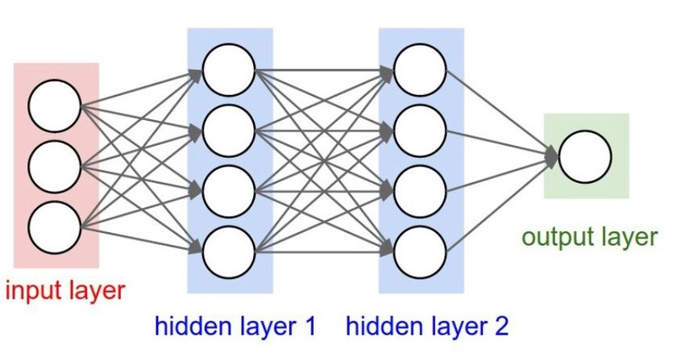
Fully Connected Networks
The neurons in each layer are connected to neurons in the following layer. We call these types of layers fully connected layers. So, when we use a dense layer in keras we are simply stating that the neurons in that layer are fully connected to the neurons in the previous layer. They typically consist of many hundreds of simple processing units which are wired together in a complex communication network.
• Each unit or node is a simplified model of a real neuron which fires (sends off a new signal) if it receives a sufficiently strong input signal from the other nodes to which it is connected.
• The output is aiming for a target.

Slide 13








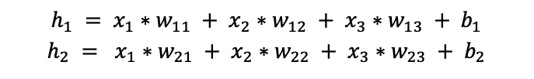
What Dense Layer Does
To understand what's going on with dense layers, we have to understand the following scenario. Let's say we have three inputs to the model ($x_{1}, x_{2}, x_{3}$), $h_{1}$ and $h_{2}$ are the neurons in our hidden layer. $\tilde{y}$ is the neuron in our output layer. Since it's the last layer it’s also the result of the model.
Here you can see the math going on in a dense layer. For example, the output value of neuron $h_{1}$ is calculated by multiplying the input $x_{1}$ with weight $w_{11}$, and then adding input $x_{2}$ multiplied by weight $w_{12}$, and then adding input $x_{3}$ multiplied by $w_{13}$, and then add the signal weight $b_{1}$.
During training, these weights and biases are being tuned to the best possible values to be able to reduce the loss between the predictions and the actual expected outputs. Hence, the weights and biases are the called the trainable parameters of the deep learning model.
$$x_{1}$$
$$x_{2}$$
$$x_{3}$$
Input
$$h_{1}$$
$$h_{2}$$
Hidden Layer
$$\tilde{y}$$
Output Layer
$$h_{1} = x_{1}∗w_{11} + x_{2}∗w_{12} + x_{3}∗w_{13} + b_{1}$$
$$h_{2} = x_{1}∗w_{21} + x_{2}∗w_{22} + x_{3}∗w_{23} + b_{2}$$
$$\tilde{y}= x_{1}∗w_{31} + x_{2}∗w_{32} + b_{3}$$

Slide 14





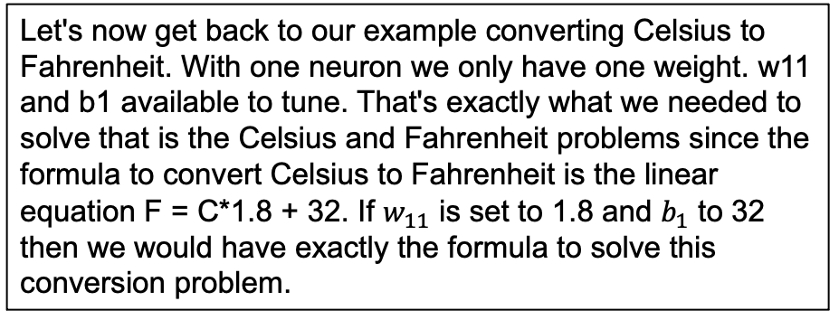

Looking back to Our Colab Code
$$h$$
Let's now get back to our example converting Celsius to Fahrenheit. With one neuron we only have one weight. w11 and b1 available to tune. That's exactly what we needed to solve that is the Celsius and Fahrenheit problems since the formula to convert Celsius to Fahrenheit is the linear equation F = C*1.8 + 32. If $w_{11}$ is set to 1.8 and $b_{1}$ to 32 then we would have exactly the formula to solve this conversion problem.
$$x$$
$$w_{11}$$
$$\tilde{y}$$
Celsius
Fahrenheit
$$\tilde{y} = x∗w_{11} + b_{1}$$
$$F = C ∗ 1.8 + 32$$
In fact, when we look at the printout from Colab, you can see that our weight and bias get tuend to the correct values to solbe Celsius to Fahrenheit conversion. The weight is tuend to close to 1.8 and bias is 32. It is just a simpel example. When working on real machine learning problem, we can hardly match the variable agains the target like this close.

Slide 15
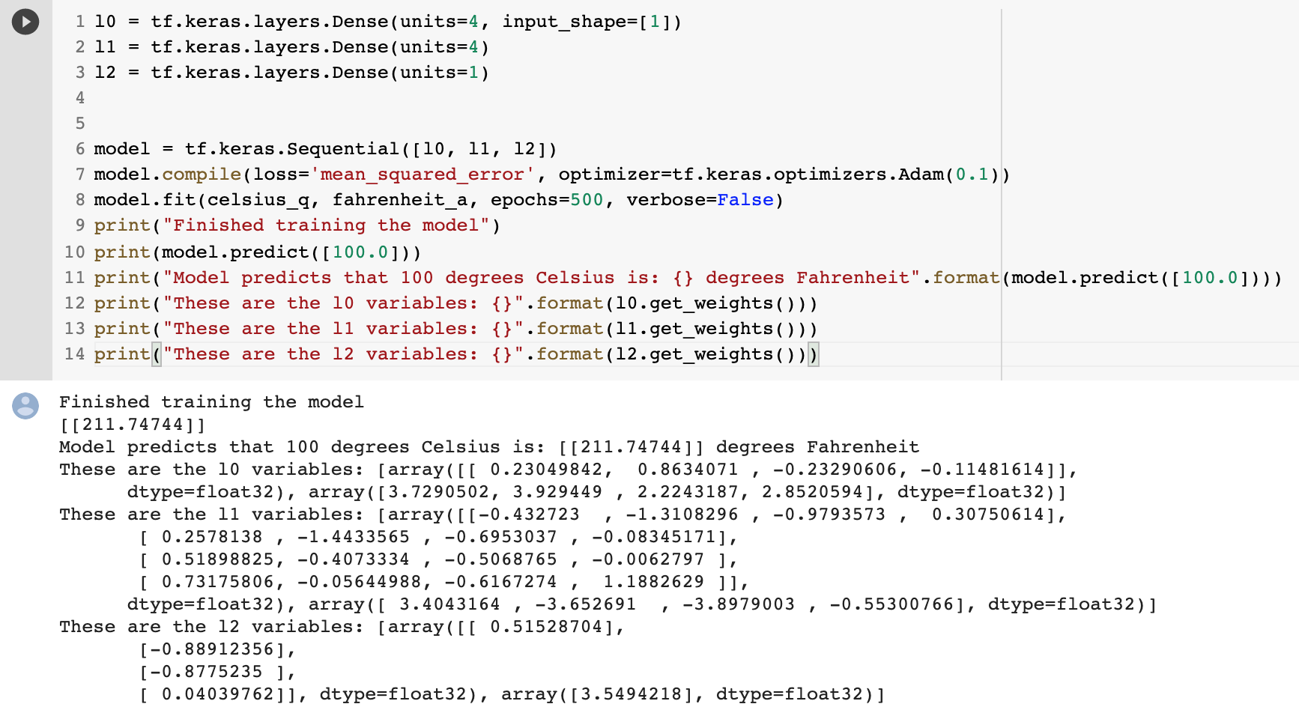
How the algorithm works in real life
Now, let's see how we would approach this problem in real life. Without knowing the target algorithm, we would just give a model several layers and weights to tune to. Then we just hope the model will be able to figure out how to tune the model algorithm to match the input to the output.
As you can see this example, it also successfully did so with this model having three layers and lots more neurons. Looking at the map now, we can see that there is no direct mapping between them and the conversion formula In general, when we do machine learning, we typically just try different neural neworks with different numbers of layers and neurons in a trial-and-error fashion and see if the model is able to solve the problem during the training phases. We will see a more concrete example next.

Slide 16
Limitations of Deep Learning
Neural networks and deep learning systems give amazing performance on many benchmark tasks but they are generally?
Very data hungry (e.g., often millions of examples)
Very compute intensive to train and deploy (GPU resources)
Poor at representing uncertainty
Easily fooled by adversarial examples
Finicky to optimize: non-convex + choice of architecture, learning procedure, initialization, require expert knowledge and experimentation
Uninterruptable black-boxes, lacking in transparency, difficult to trust

Slide 17
Reference
Slide 2: https://www.ibm.com/cloud/learn/machine-learning

